Slide 1
SI 671 Discussion 3
Introduction to
Mining Matrix Data

Slide 2
Outline
Basic Natural Language Processing
Word representation
TF-IDF + SVD
Recommendation system
Notes:
Regex:
https://regexr.com/
https://learn.microsoft.com/en-us/dotnet/standard/base-types/regular-expression-language-quick-reference

Slide 3
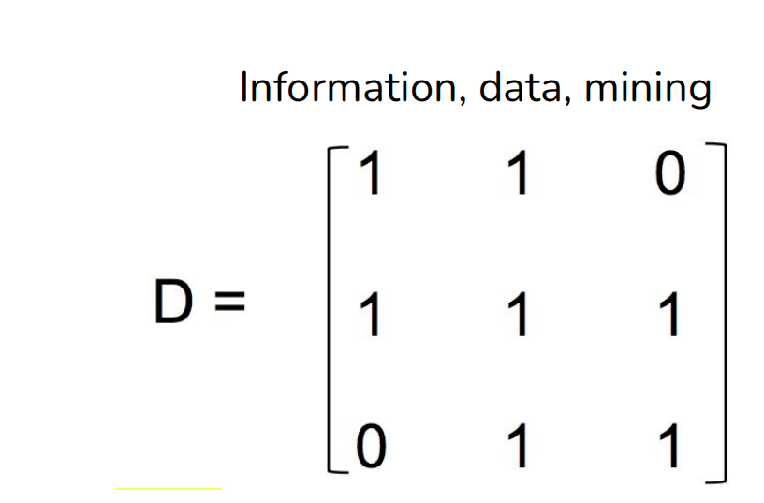
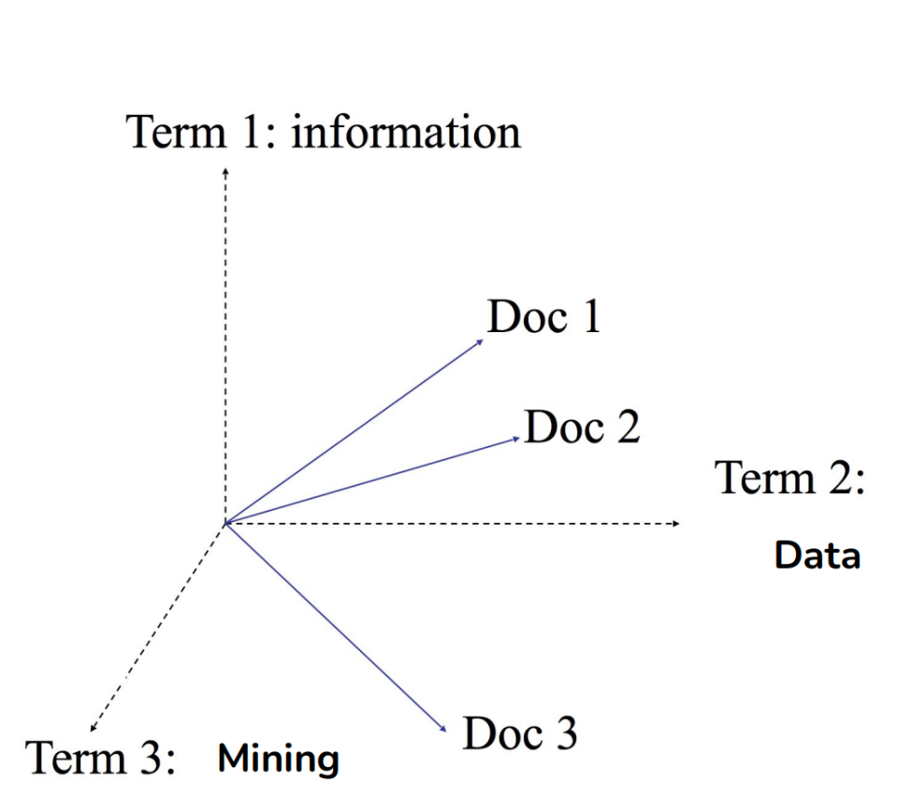
Text to Matrix
Doc 1: “information data”
Doc 2: “information data mining”
Doc 3: “data mining”
Vocabulary: information, data, mining
Doc 1: <1, 1, 0>
Doc 2: <1, 1, 1>
Doc 3: <0, 1, 1>
What if Doc 4: “data mining data”?
What if Doc 5: “data <unknown>” (“data analysis”)?
Which document is closer to Doc 1?
Euclidean distance vs. cosine similarity?

Slide 4
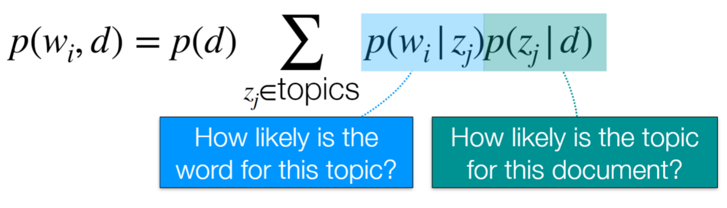
Topic Modeling
What?
Topic modeling assumes that documents are mixtures of topics, and words are associated with these topics. The key idea is to extract meaningful patterns from the distribution of words in the documents and assign each document a distribution of topics that best represents its content.
How?
Usually LDA (Latent Dirichlet Allocation)
Latent Semantic Analysis: TF-IDF + Truncated SVD

Slide 5
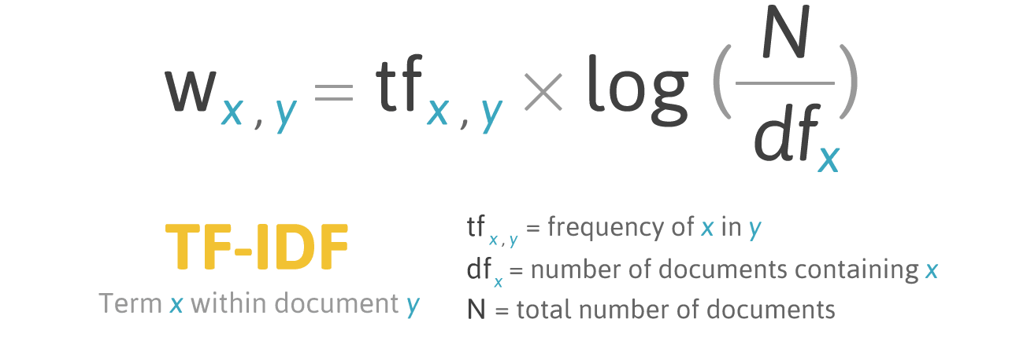
TF-IDF
It is a measure of importance of a word to a document in a collection or corpus.
Notes:
– Term is common in doc high tf high weight
– Term is rare in collection high idf high weight
TF-IDF is a way to assess the importance of terms in documents by considering both their local (within the document) and global (across the corpus) characteristics. It's a valuable tool in text analysis and information retrieval for ranking and analyzing documents based on their content.

Slide 6
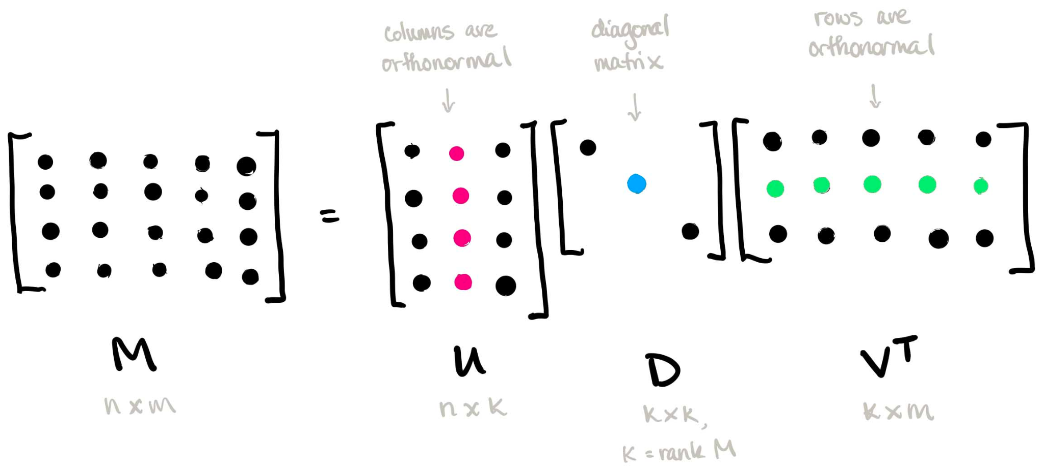
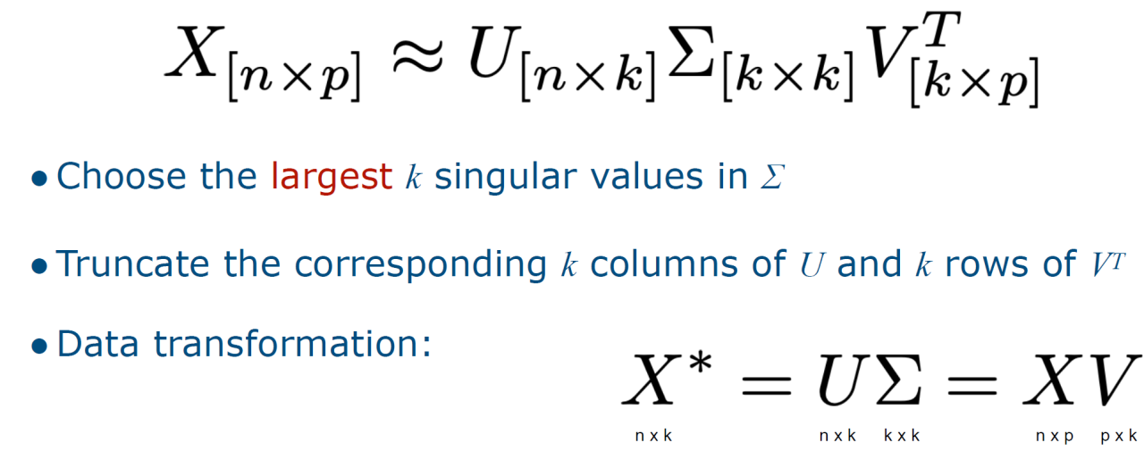
Truncated SVD
U: left singular vectors
V: right singular vectors
Σ: single values in descending order

Slide 7
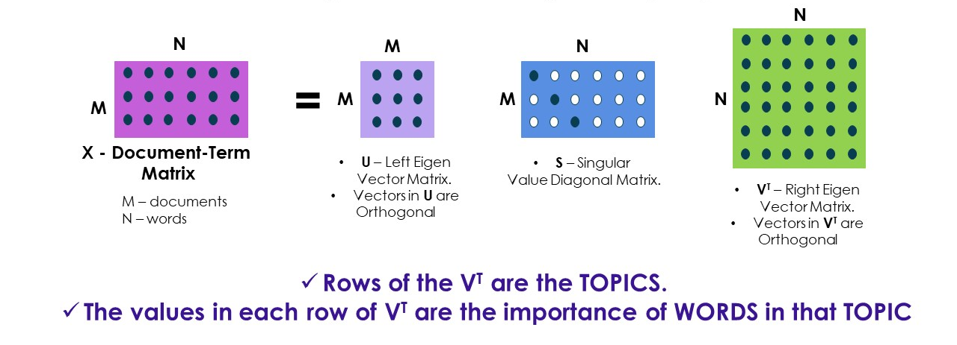
SVD in Latent Semantic Analysis
Notes:
U: document - topic
S: topic strength or topic distribution
V: topic - term

Slide 8
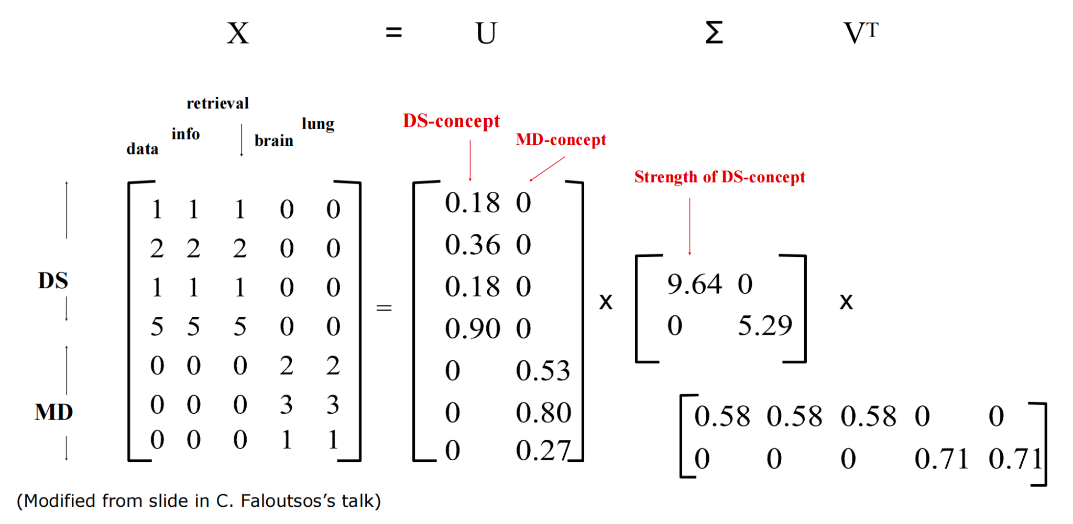

Slide 9
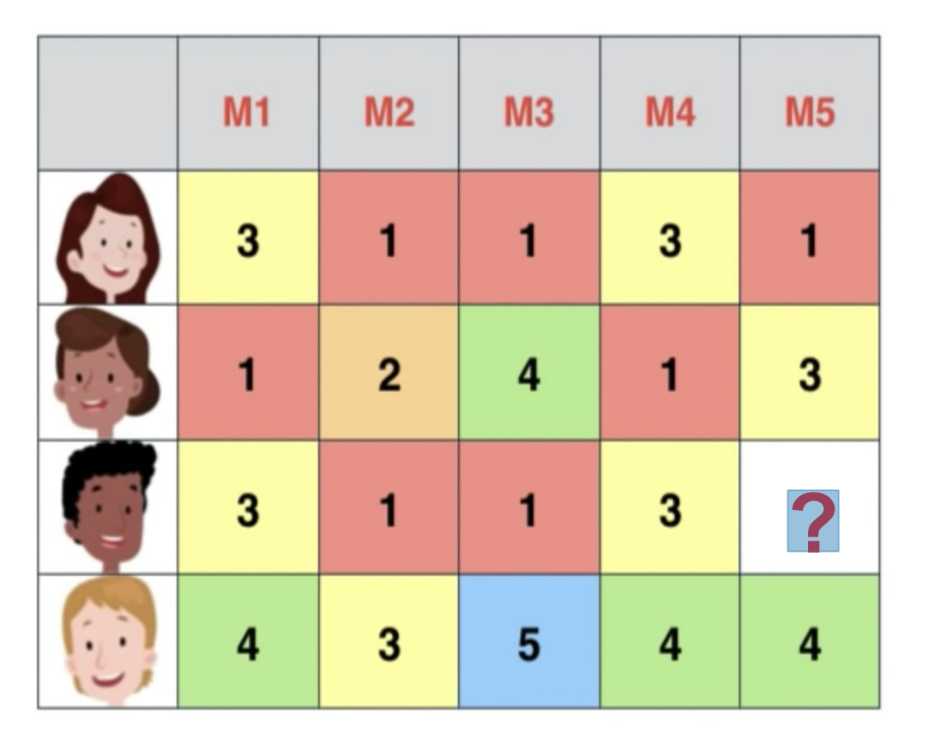
Recommendation System
Notes:
User - genre - movies

Slide 10
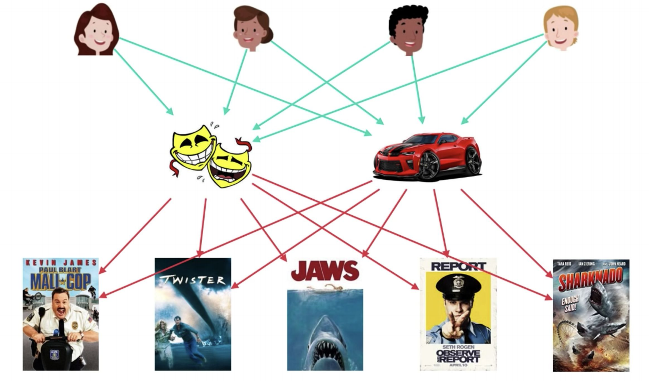
Notes:
Audience - genre: user clustering/similarity
Genre distribution: comedy / action film
Genre - movie: movie similarity

Slide 11
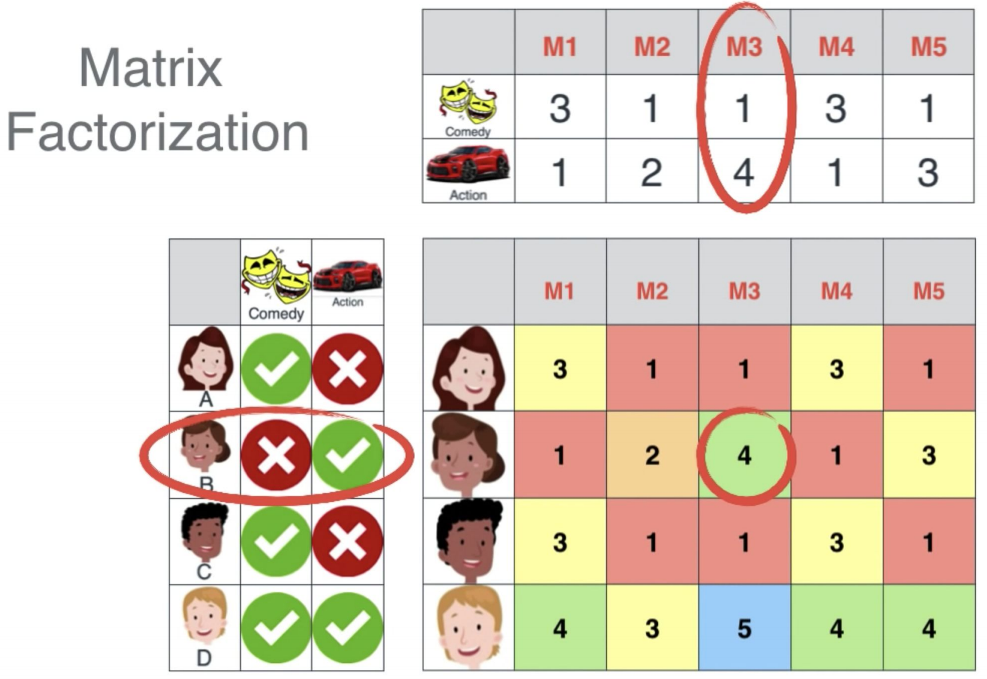
Collaborative Filtering: Matrix Factorization

Slide 12
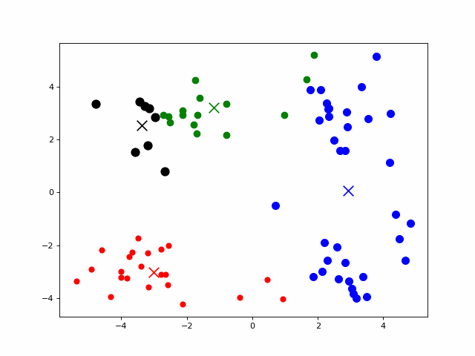
K-Means
Specify number of clusters K.
Initialize centroids by randomly selecting K data points for the centroids.
Keep iterating until there is no change to the centroids.
Why matrix factorization?

Slide 13
Curse of Dimensionality
One of the main drawbacks of using k-means for high-dimensional data is the curse of dimensionality, which refers to the fact that as the number of dimensions increases, the distance between any two data points becomes more similar and less meaningful. This makes it harder for k-means to find distinct and coherent clusters, as the centroids may not represent the true structure of the data.

Slide 14
The rest is for fun!

Slide 15
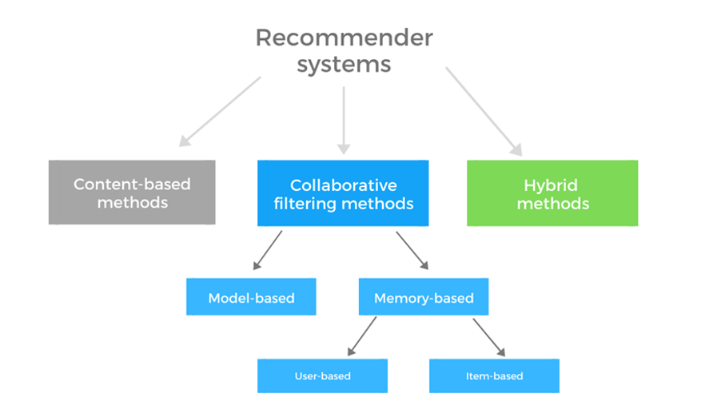
Recommendation System
Notes:
Recommendation systems use a number of different technologies. We can classify these systems into two broad groups.
Content-based systems examine properties of the items recommended. For instance, if a Netflix user has watched many cowboy movies, then recommend a movie classified in the database as having the “cowboy” genre.
Collaborative filtering systems recommend items based on similarity measures between users and/or items. The items recommended to a user are those preferred by similar users.
Refer to CS246 MMDS. http://infolab.stanford.edu/~ullman/mmds/ch9.pdf

Slide 16

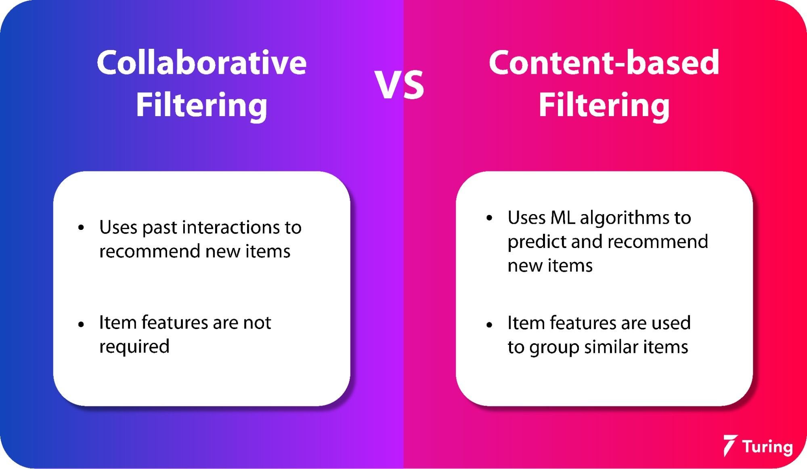
Collaborative vs. Content-based
Notes:
Interaction: voting, rating
Item-based collaborative vs. Content-based: https://stackoverflow.com/questions/16372191/whats-difference-between-item-based-and-content-based-collaborative-filtering

Slide 17
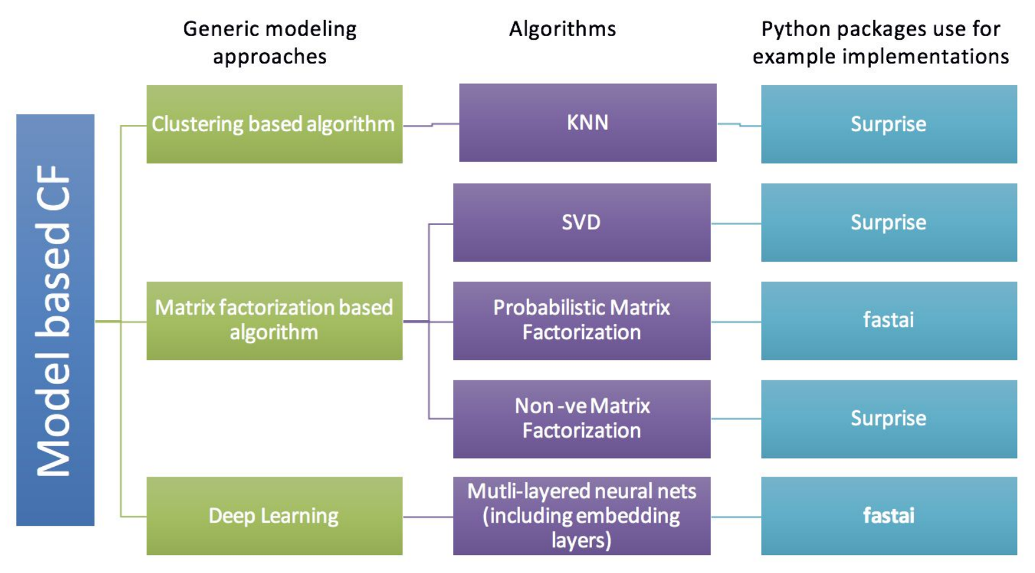
Collaborative Filtering

Slide 18
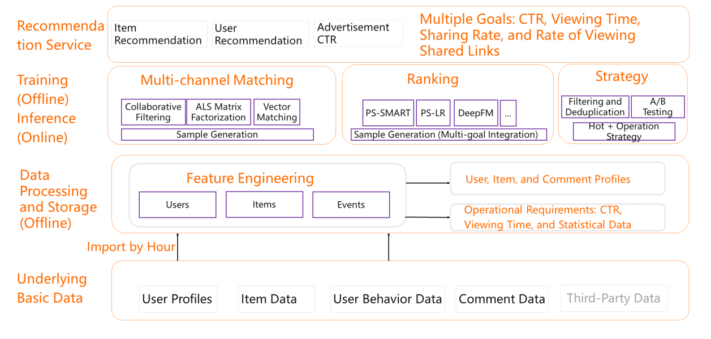
Overall Architecture of A Recommender System
Notes:
Stream mining
A/B testing
CTR：Click-through Rate
Alternating Least Square (ALS) Matrix Factorization: https://towardsdatascience.com/prototyping-a-recommender-system-step-by-step-part-2-alternating-least-square-als-matrix-4a76c58714a1
Refer to: https://www.alibabacloud.com/blog/basic-concepts-and-architecture-of-a-recommender-system_596642

